Slide 1
The Brilliance of the Brain
*This is an automatic slideshow. You will not need to press any buttons to continue.

Slide 2
The Cortex
The cortex is the outermost layer of the brain. It has four lobes and is divided into left and right hemispheres. Here comes the cortex now!

Slide 3
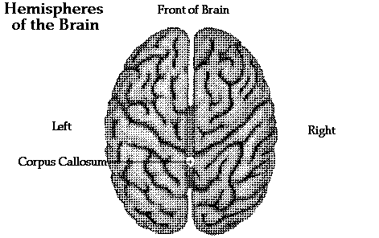
The Corpus Callosum
The corpus callosum is a band of neurons that connects the left and right hemispheres of our wrinkly cortex. This way, information from either side of the body can go to either hemisphere. It is highlighted in blue.

Slide 4
The Frontal Lobes
The frontal lobes are in the front of the brain. They help us make decisions and speak fluently. They make up about 30% of our brain!

Slide 5
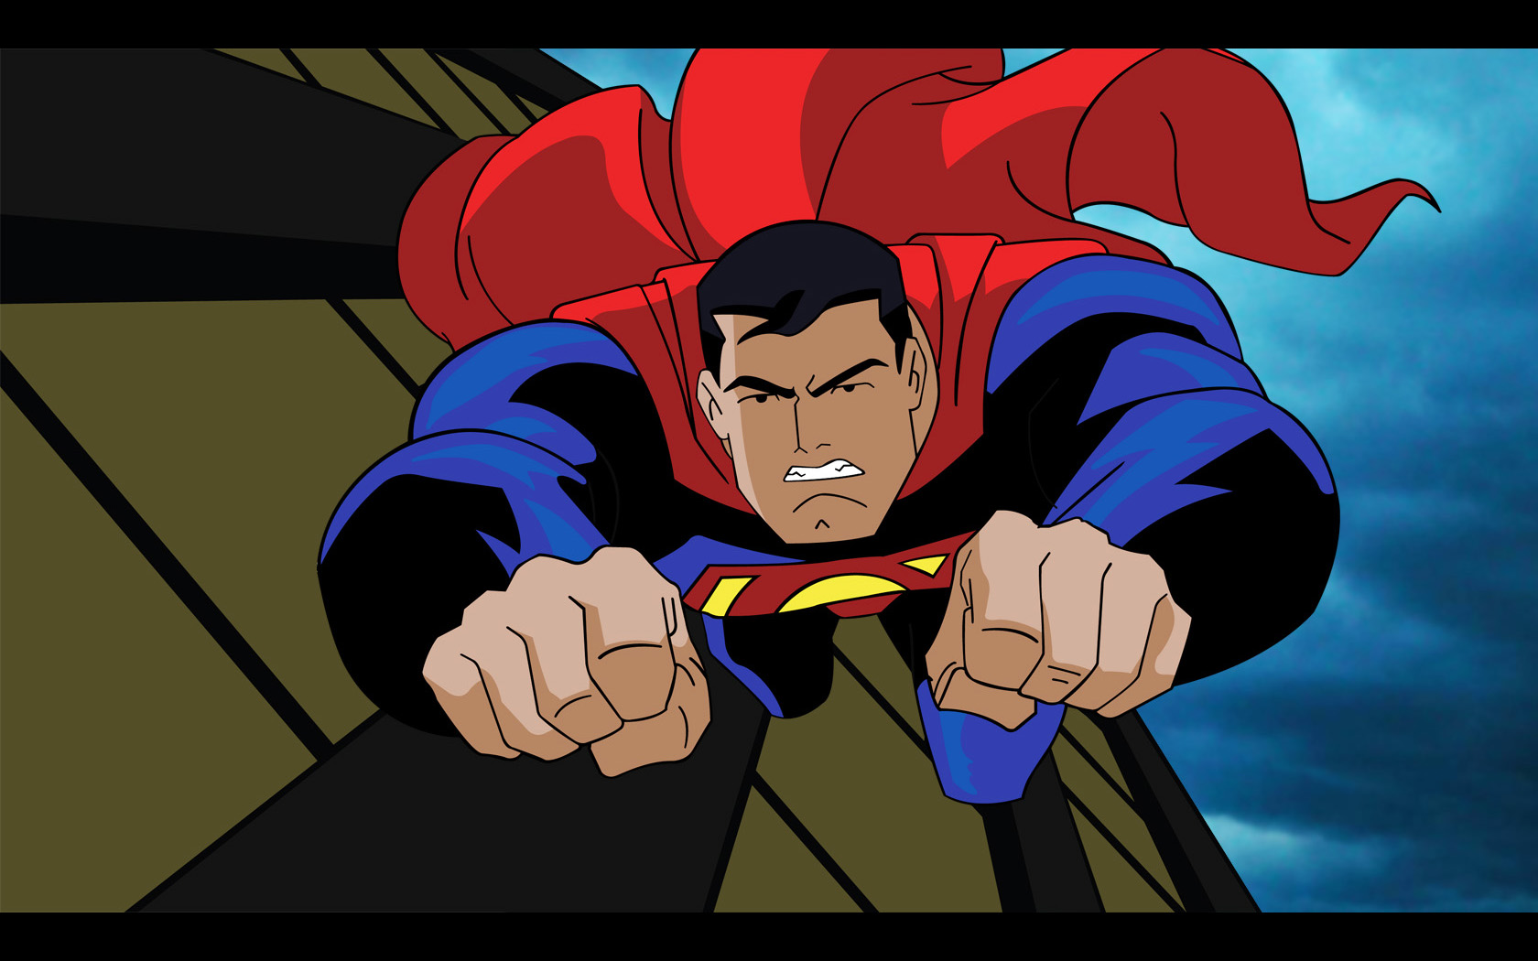
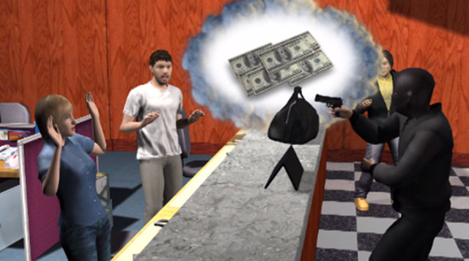
Take Superman for example. His frontal lobes help him make decisions and decide who is good and who is bad.

Slide 6
*EXTRA FACT!
The frontal lobes are also responsible for our personality and emotion. Also, in our left temporal lobe there is an area called Broca’s Area. It is responsible for letting us produce meaningful speech. We’ll talk more about this later.

Slide 7
The Temporal Lobes
Frontal Lobe
The temporal lobes are located above our ears near our temples. They help us understand auditory information and also include the auditory cortex, which is helpful in hearing. The temporal lobes also help us recognize faces.
Temporal Lobe

Slide 8
Dan can’t seem to remember what his high school friend looks like. He has his temporal lobes to blame for that!

Slide 9
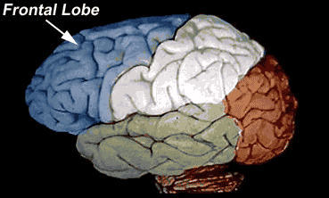
The Parietal Lobes
Parietal Lobe
The parietal lobe is responsible for touch and our spatial sense. This means it helps us recognize depth and space between us and other objects.

Slide 10
The Occipital Lobes
Parietal Lobe
The occipital lobe contains the visual cortex, which processes visual information. The occipital lobe is almost solely responsible for visual processing.
Occipital Lobe

Slide 11
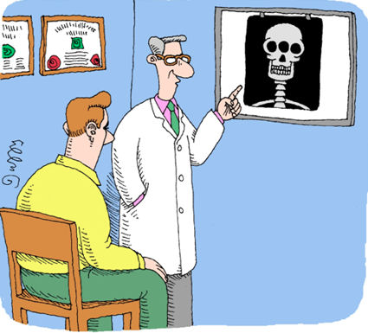
Randy has been experiencing difficulty in visual processing. Can you guess what his doctors decided to check? That’s right, his occipital lobe.

Slide 12
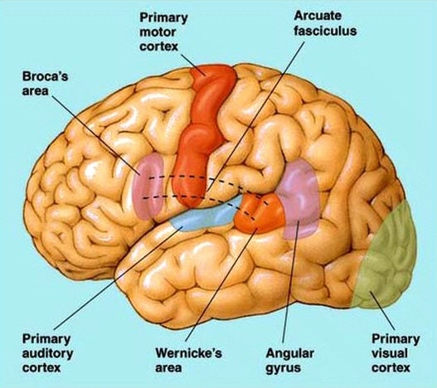
Broca’s Area
As stated earlier, Broca’s Area is responsible for producing meaningful speech by controlling the muscles in our mouth. If Broca’s area is damaged, it results in Broca’s aphasia, where one would have problems speaking or even writing anything meaningful.

Slide 13
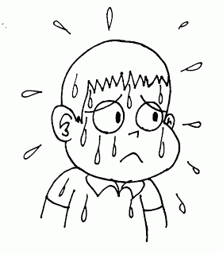
Phew! This has been exhausting but we are almost finished. Hang in there!

Slide 14
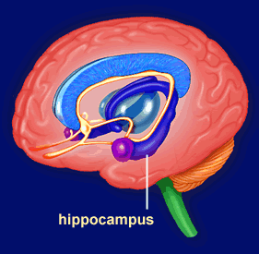
Hippocampus
So far, we have only been talking about brain structures within the cerebral cortex, the outer layer of our brain. Now, let’s take a look at a structure underneath the cortex. The hippocampus is primarily responsible for learning new memories and remembering.

Slide 15
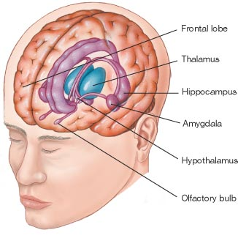
Thalamus
The thalamus is also located underneath the cerebral cortex. It allows for a connection to the cerebral cortex. Its main function is to send information from our senses directly to the cortex (except for our sense of smell). Think of it like a traffic conductor, directing information from the senses directly to different parts of the cortex.

Slide 16
We’re Finished!
Now that we’re done, let me tell you why I chose only these brain parts.
The four lobes of the cerebral cortex are necessary to understand. They perform some of the higher mental processes. It was necessary to cover the outer layer of the brain before going into the rest.
The corpus callosum is something everyone needs to know to understand how both hemispheres of the brain are connected. This is why I chose it.
Broca’s area is responsible for producing speech. It is an important structure that is found in the frontal lobe. Broca’s area as well as Broca’s aphasia are extra facts one can know about the frontal lobe.
The hippocampus should never be forgotten as it is responsible for memory. It is obvious that when learning about the brain, one understands a key component of our brain responsible for a very important function: memory.
Finally, the thalamus is the gateway to the cortex. This is essential to understand when trying to comprehend how information from the senses is sent to the cortex.

Slide 17
Sources of the Pictures
http://cwx.prenhall.com/bookbind/pubbooks/morris5/medialib/images/F02_09.jpg
http://morphonix.com/software/education/science/brain/game/specimens/images/hippocampus.gif
http://3.bp.blogspot.com/-isyhbQNOc6k/TdrCl4dh_II/AAAAAAAAAC4/8lqet2_oW38/s320/sweating.gif
http://www.acbrown.com/neuro/Lectures/Lang/Figs/NrLang13.jpg
http://www.acpinternist.org/weekly/archives/2010/2/23/cartoon.jpg
http://2.bp.blogspot.com/-uY8Ya5C1rIE/UBxVlY2SwnI/AAAAAAAAAHA/_tu7-WNSzA4/s1600/man-confused-cartoon-face.jpg
http://peace.saumag.edu/faculty/kardas/Images/Web%20Images/Lecture/braintop.GIF
http://news.medill.northwestern.edu/uploadedImages/News/Chicago/Images/Science/robber(1).jpg
http://fc02.deviantart.net/fs39/f/2009/001/7/4/Superman_Animated_by_DanielGoettig.jpg
http://faculty.washington.edu/chudler/gif/lobeani.gif
http://morphonix.com/software/education/science/brain/game/specimens/images/cerebral_cortex_lobes.gif
http://www.clker.com/cliparts/0/1/0/1/123756079190465860pitr_LEGO_smiley_--_cool.svg.hi.png

